Slide 1
Strain gauges, resistors review, and capacitors

Slide 2
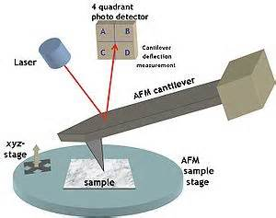
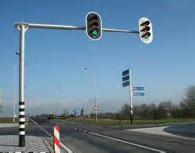
Cantilever beams

Slide 3
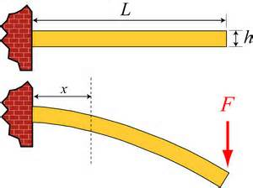
Beams bend when loaded

Slide 4
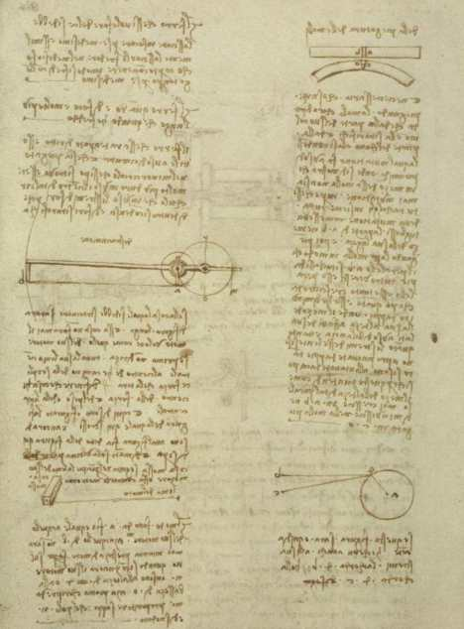
DaVinci-1493
How does the loading deform the beam?
"Of bending of the springs: If a straight spring is bent, it is necessary that its convex part become thinner and its concave part, thicker. This modification is pyramidal, and consequently, there will never be a change in the middle of the spring. You shall discover, if you consider all of the aforementioned modifications, that by taking part 'ab' in the middle of its length and then bending the spring in a way that the two parallel lines, 'a' and 'b' touch a the bottom, the distance between the parallel lines has grown as much at the top as it has diminished at the bottom. Therefore, the center of its height has become much like a balance for the sides. And the ends of those lines draw as close at the bottom as much as they draw away at the top. From this you will understand why the center of the height of the parallels never increases in 'ab' nor diminishes in the bent spring at 'co.'

Slide 5
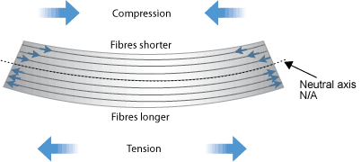
What was Da Vinci saying?
How do we relate elongation/compression to the load on the beam?

Slide 6
Stress
F
F
A_{o}
F
average
normal stress
over the
cross-section
σ =
A_{o}

Slide 7
Strain = normalized deformation
L_{o}
dx
F
F
A_{o}
ε =
dx
L_{o}

Slide 8
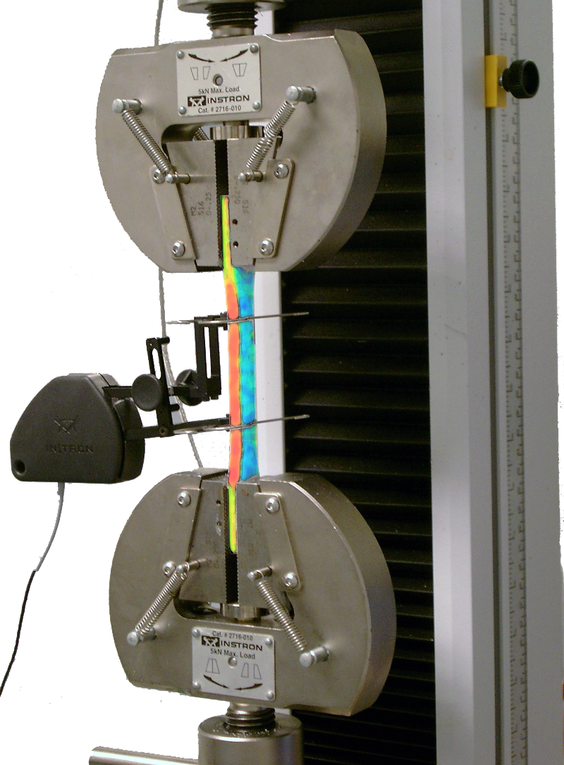
How are stress and strain related?
Tension Test
test specimen
extensometer
(measures strain)
load cell
(measures force)

Slide 9
σ
Linear elastic behavior
Hooke’s Law
When loading is released, material returns to its original length.
σ_{y}
yield stress
slope = E (Young’s Modulus)
property of a material
Aluminum: E = 275 MPa
ε

Slide 10
Strain in cantilever beam (will use this formula next week)
h
P
L
b

Slide 11
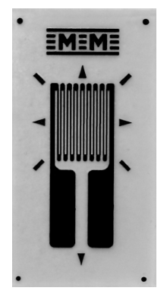
Strain gauges measure axial strain
The resistance of gage changes as it stretches or compresses.
Strain gauges must be well attached to the surface of a material so that it deforms as the material deforms.
6.4 x 4.3 mm

Slide 12
Strain is proportional to the change of resistance
R is nominal resistance
GF is gage factor-a calibration constant. Ours have GF = 2.1
Change in resistance is very small-need a circuit to measure.

Slide 13
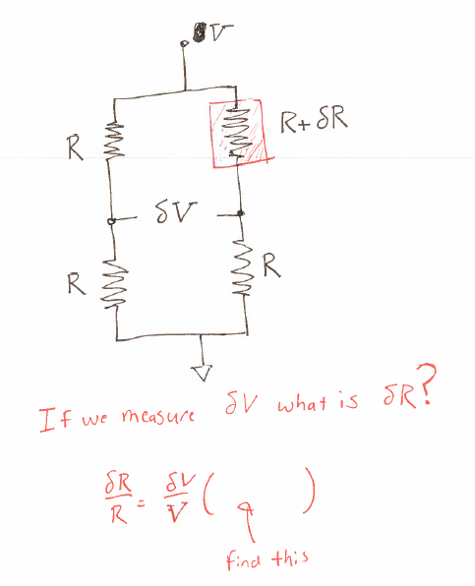
Bridge circuit

Slide 14
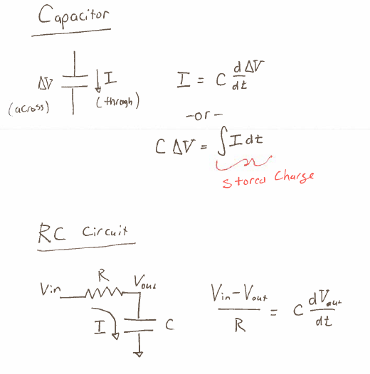

Slide 15
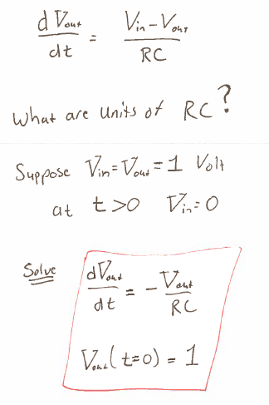
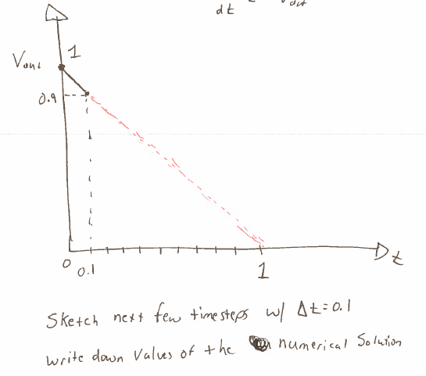

Slide 16
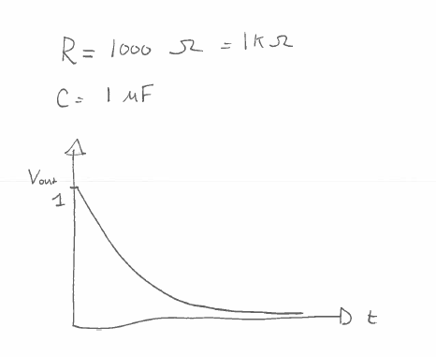
Put on approximate time units .

Slide 17
