Slide 1
Introduction to Sensors, Instrumentation, and Measurement

Slide 2
Measuring things
Measurements are essential to all branches science and engineering.
Much (all?)of our understanding of the world was born from experimental measurements .
Models of systems are useless without validation.
“Experiment is the sole judge of scientific truth” Feynman

Slide 3
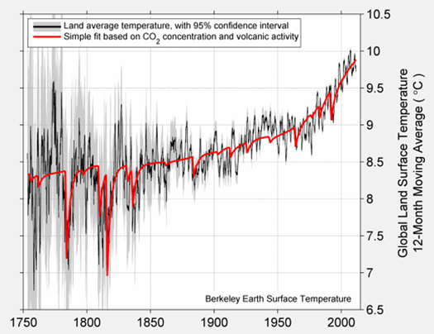
Measurements are debated
Berkeleyearth.org

Slide 4
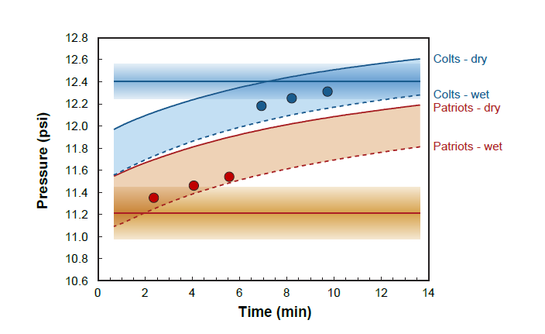
Measurements are debated and so very important!

Slide 5
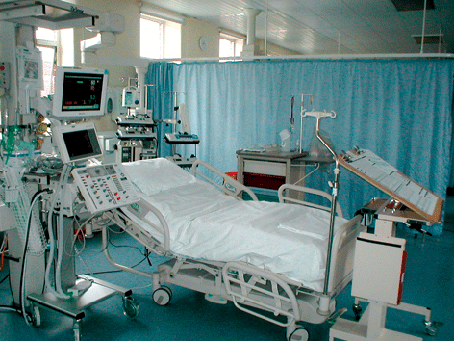
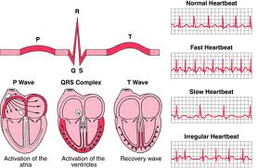
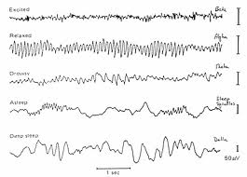
Measurements are important in healthcare

Slide 6
Would you fly without sensors?

Slide 7
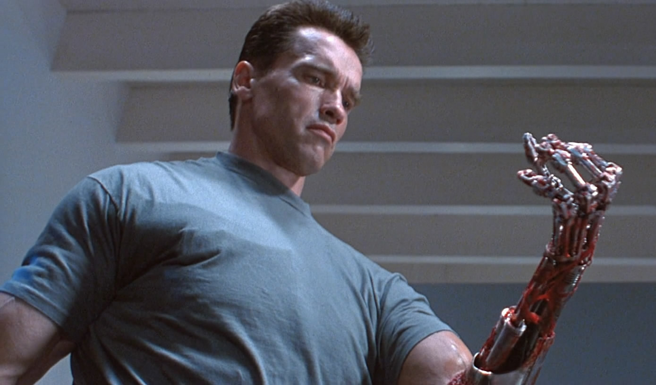
Robots need to touch and see

Slide 8
Measurements can tell us how the universe is built
Large hadron collider

Slide 9
But this is only a first course. What you will learn (hopefully)
Make a set of physical measurements.
Analyze and present experiment data.
Use measurements test physical models.
Build circuits to interface sensors with a computer.
Analyze and design simple circuits.

Slide 10
Course structure (some details TBD)
Week 1 | Individual Lab: Intro - pendulum
Week 2 | Individual Lab: Mechanical – Stress/strain
Week 3 | Individual Lab: Mechanical – Stress/strain
Week 4 | Individual Lab: EKG
Week 5 | Individual Lab: Measurement with light
Week 6 | Individual Lab: Blood glucose
Week 7 | Individual Lab: Blood pressure
Week 8 | Individual Lab: Ballistocardiograph
Week 9 | Individual Lab: Ultrasound
Week 10 | Individual Lab: Ultrasound
Week 11 | Team Project
Week 12 | Team Project
Week 13 | Team Project
Week 14 | Finish up

Slide 11
A few things.
This is not just an ECE course – but many measurements are electronic (all in this course).
Ninjas.
Lab reports – focus mainly on results.
Weekly labs will be individual.
Project will be in groups of about 4.

Slide 12
Grades – pass/no-record
Conjecture: If you turn everything in, come to class, spend a reasonable amount of time on homework, and put forth a reasonable effort, the probability of passing (and actually learning a lot) is 100%.
Corollary: You can no-record by not doing the above mentioned tasks.
Use pass/no-record to focus on learning, but turn your s#$# in!

Slide 13
Some tips
Don’t sweat it if you don’t get something perfect the first time, we will work on same topics repeatedly.
Most of the material will be new for most of you.
Strive to learn good skills and habits for future semesters.
A lab missing a few small things or with imperfect data is better than none at all.
Use faculty and Ninjas if you are confused.
Seek us out if you are having trouble with the class or if outside issues are causing you to fall behind.

Slide 14
Lab etiquette
Don’t take equipment/tools that aren’t yours.
Put things back when done.
Don’t leave your junk lying around – the classroom is shared.
Throw away old (cheap) parts, your old paper, etc
Obey the golden rule, not the tragedy of the commons

Slide 15
Website
isim.olin.edu
Readings posted before each Monday class.
Read through the lab once before your session.

Slide 16
Resistors
Twinkle, twinkle little star, V = IR

Slide 17
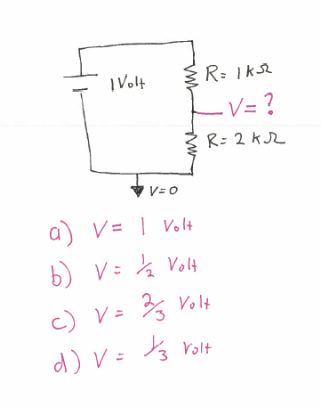

Slide 18
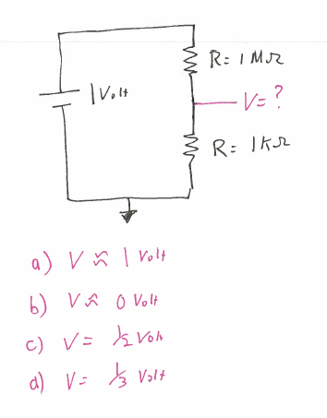

Slide 19
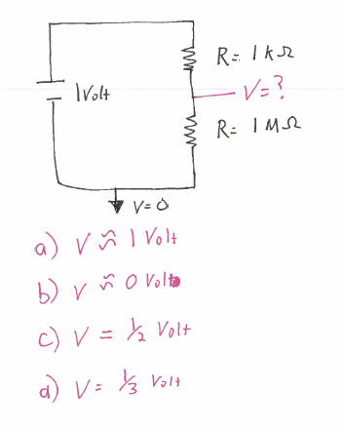

Slide 20
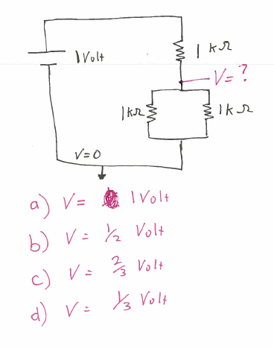

Slide 21
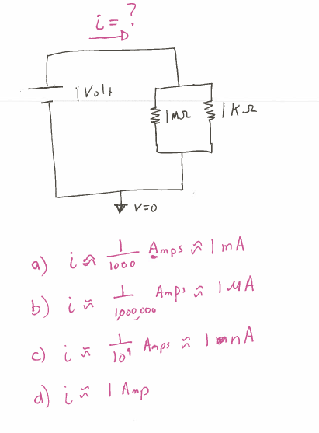

Slide 22
