Slide 1
Introduction to Sensors, Instrumentation, and Measurement

Slide 2
This is a new class
Sort of….
You will hear rumors – which may or may not be true!
Some new labs may work less well than some that have been tried and true.

Slide 3
Measuring things
Measurements are essential to all branches science and engineering.
Much (all?)of our understanding of the world was born from experimental measurements .
Models of systems are useless without validation.
“Experiment is the sole judge of scientific truth” Feynman

Slide 4
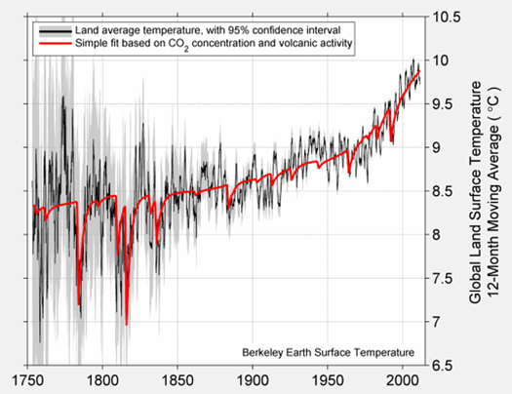
Measurements are debated
Berkeleyearth.org

Slide 5
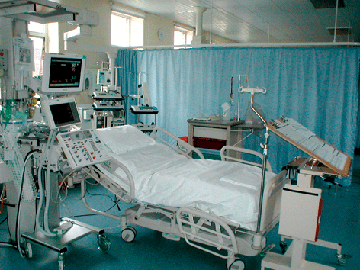
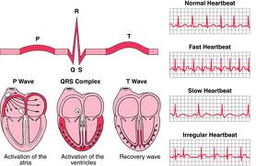
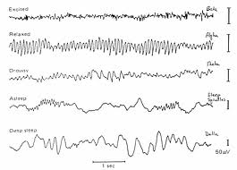
Measurements are important in healthcare

Slide 6
Would you fly without measurements?

Slide 7
Measurements can tell us how the universe is built
Large hadron collider

Slide 8
What you will learn (hopefully)
Make a set of physical measurements.
Analyze and present experiment data.
Use measurements test physical models.
Build circuits to interface sensors with a computer.
Analyze and design simple circuits.

Slide 9
Course structure (some details TBD)
Week 1 | Individual Lab: Intro - pendulum
Week 2 | Individual Lab: Mechanical – Stress/strain
Week 3 | Individual Lab: Mechanical – Stress/strain
Week 4 | Individual Lab: EKG
Week 5 | Individual Lab: Pulse measurement with light
Week 6 | Individual Lab: Blood glucose
Week 7 | Individual Lab: Blood pressure
Week 8 | Individual Lab: Ballistocardiograph
Week 9 | Individual Lab: Ultrasound
Week 10 | Individual Lab: Ultrasound
Week 11 | Team Project
Week 12 | Team Project
Week 13 | Team Project
Week 14 | Finish up

Slide 10
A few things.
This is not just an ECE course – but many measurements are electronic (all in this course).
Ninjas.
Lab reports – focus mainly on results.
Weekly labs will be individual.
Project will be in groups of about 4.

Slide 11
Grades – pass/no-record
Conjecture: If you turn everything in, come to class, spend a reasonable amount of time on homework, and put forth a reasonable effort, the probability of passing is 100%.
Corollary: You can fail by not doing the above mentioned tasks.

Slide 12
Some tips
Don’t sweat it if you don’t get something perfect the first time, we will work on same topics many different times.
But don’t zone out either
You didn’t learn to walk or talk in one moment either.
But you kept trying
Use faculty and Ninjas if you are confused. Seek us out if you are having trouble.

Slide 13
Lab etiquette
Don’t take equipment/tools that aren’t yours.
Put things back when done.
Don’t leave your junk lying around.
Throw away old parts, your old paper, etc
Obey the golden rule, not the tragedy of the commons

Slide 14
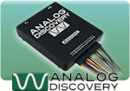
Lab equipment

Slide 15
Website
isim.olin.edu

